Slide 1
Spark Columnar/Native Engines

Slide 2
Databricks Photon
proprietary, non-free, closed-source
supposedly in C++, faster than basic spark

Slide 3
Gluten
https://github.com/apache/incubator-gluten
https://gluten.apache.org/

Slide 4
Gluten
Gluten
Substrait Java
Substrait C++
one of
Spark
Substrait(Spec)
Velox
ClickHouse
Arrow

Slide 5
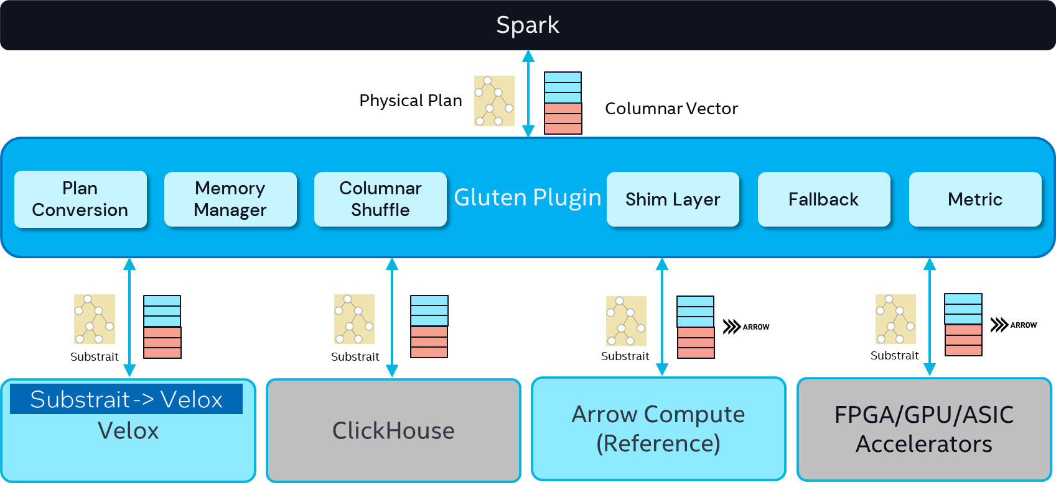
Gluten Architecture

Slide 6
Velox (Facebook)
https://github.com/facebookincubator/velox
A C++ vectorized database acceleration library aimed to optimizing query engines and data processing systems.

Slide 7
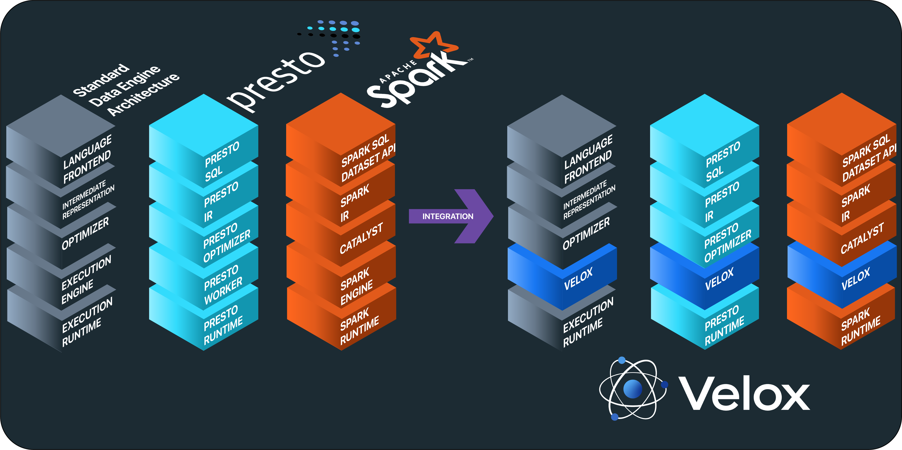
Velox ... C++ engine (presto, ..)

Slide 8
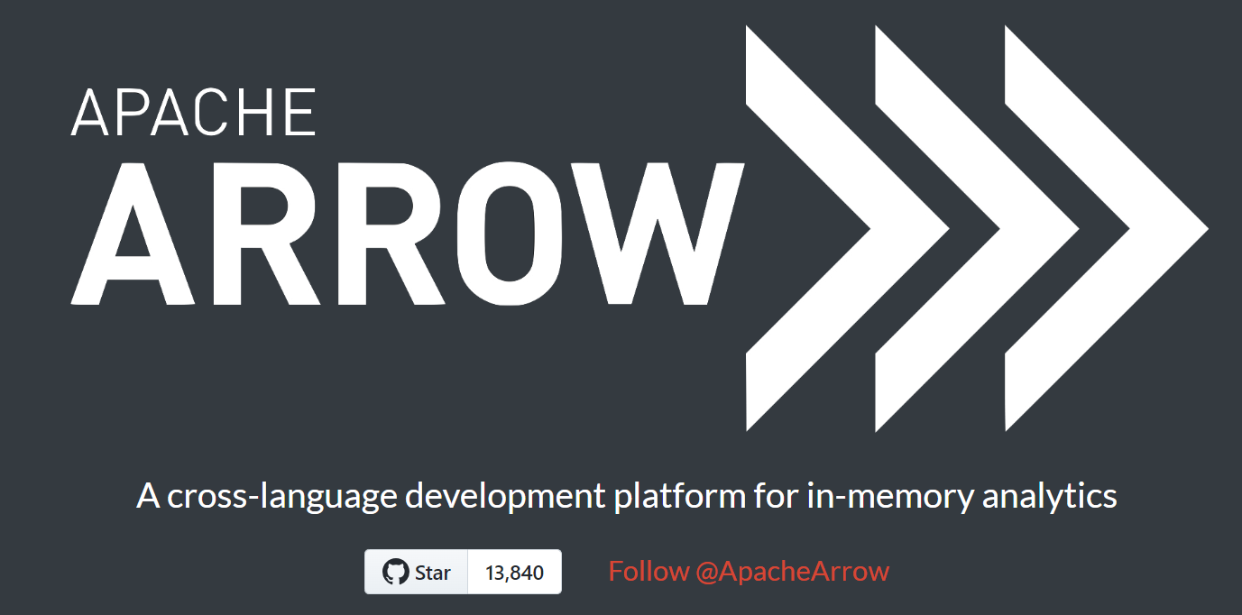
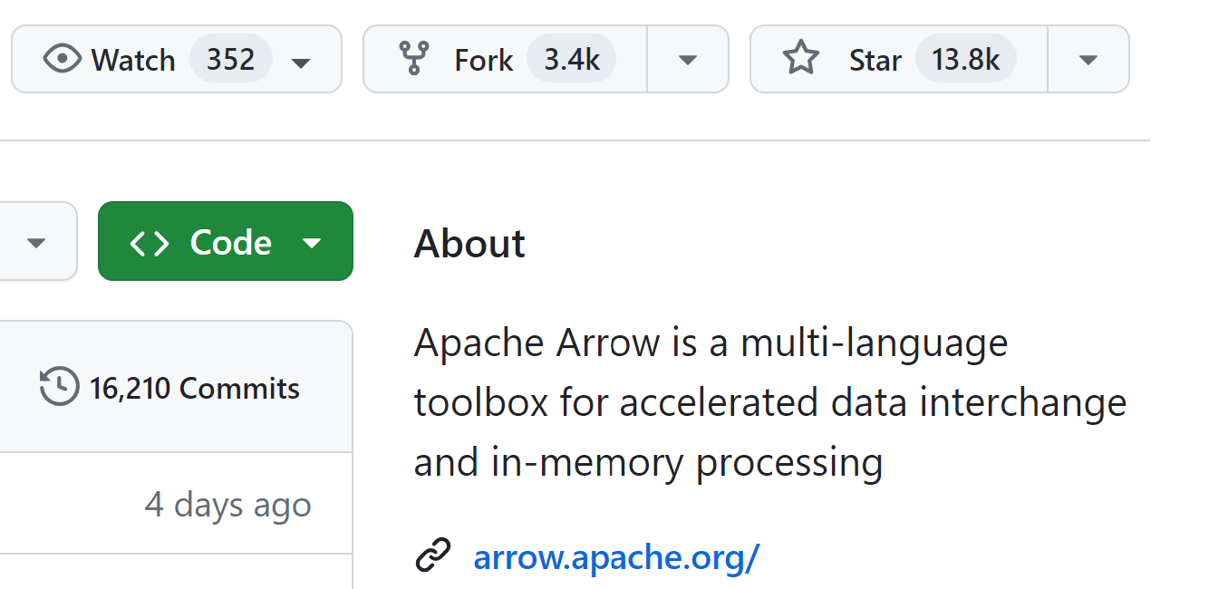
Apache Arrow
https://arrow.apache.org/
https://github.com/apache/arrow

Slide 9
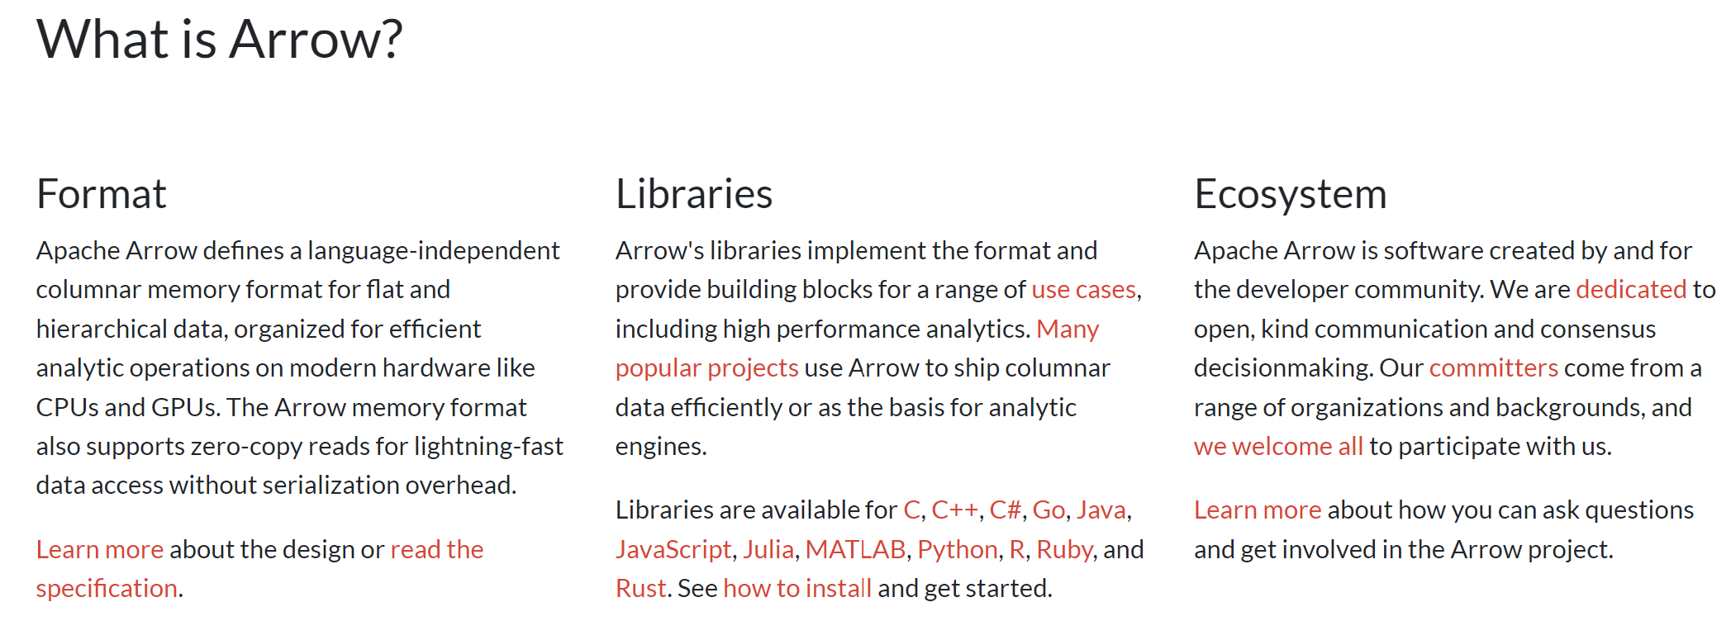
Apache Arrow

Slide 10
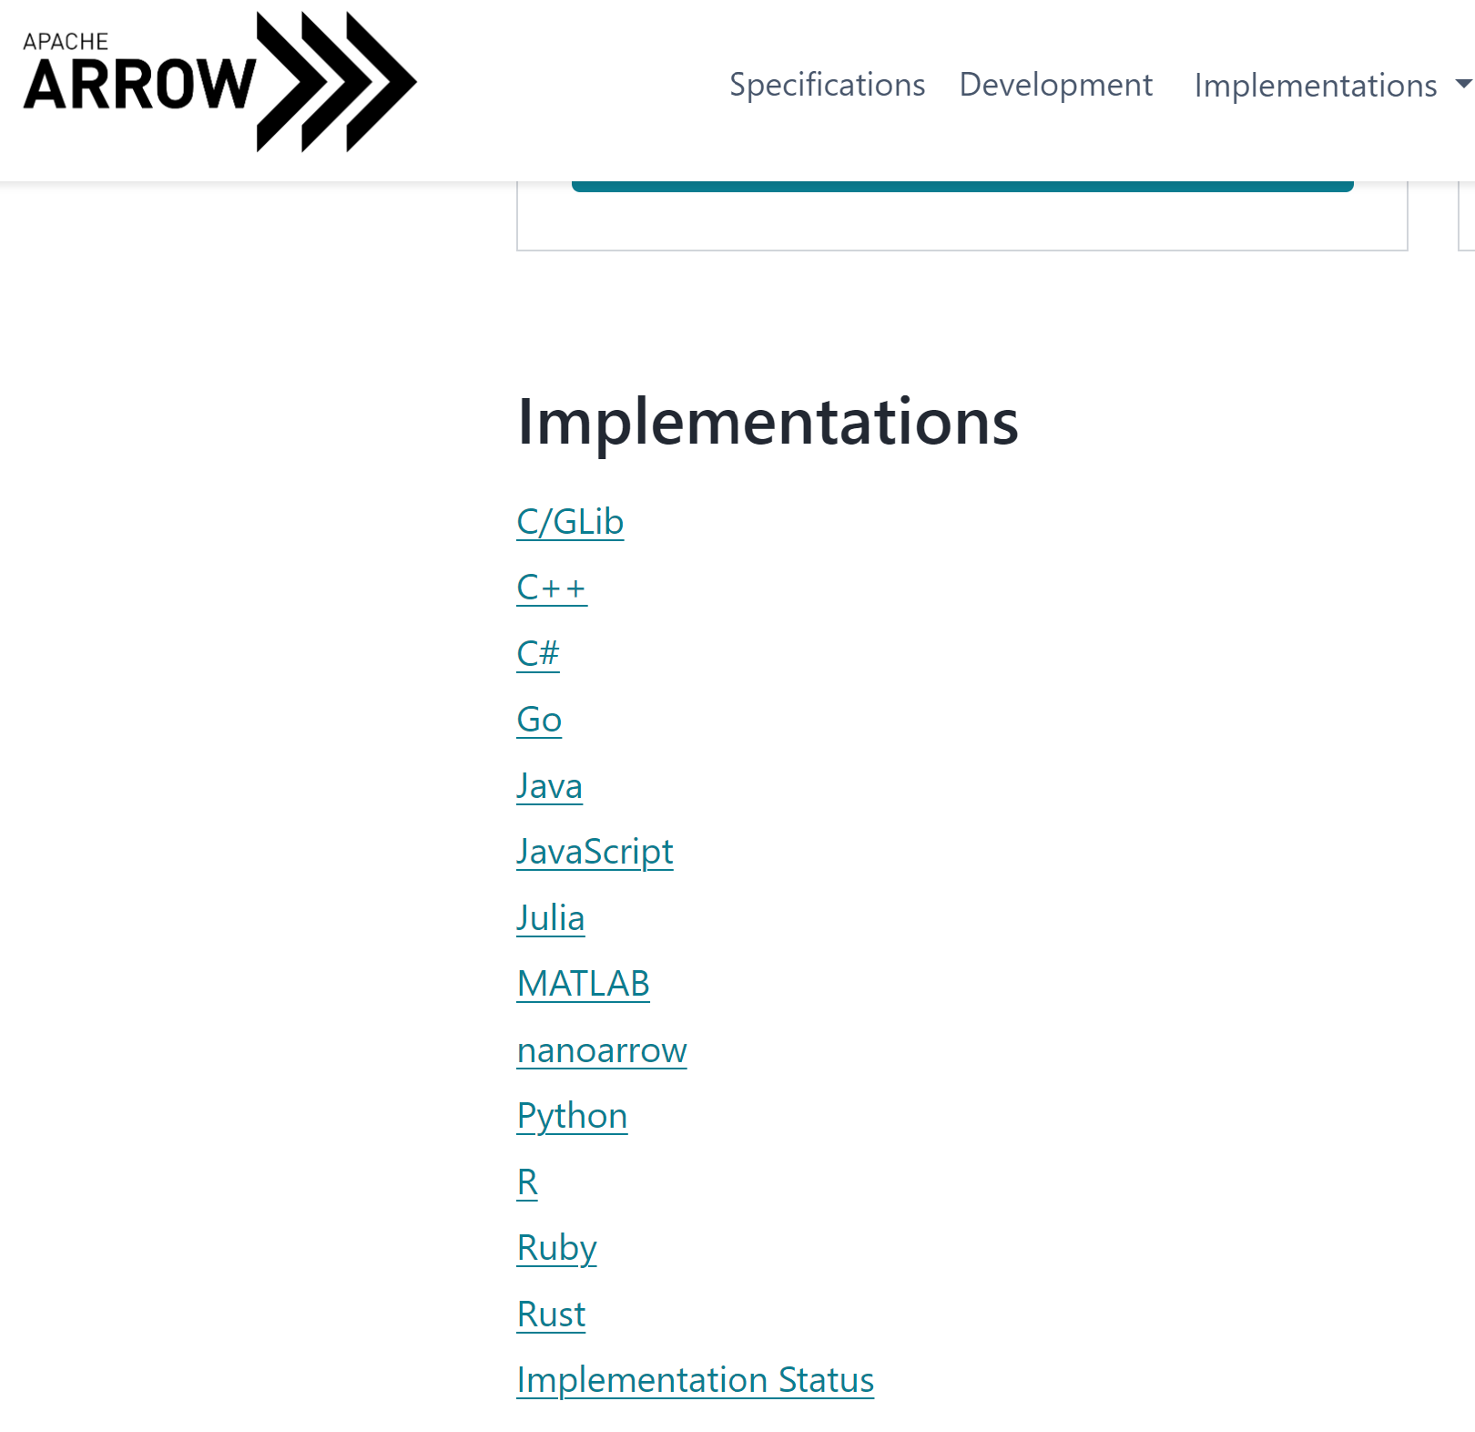
Apache Arrow

Slide 11
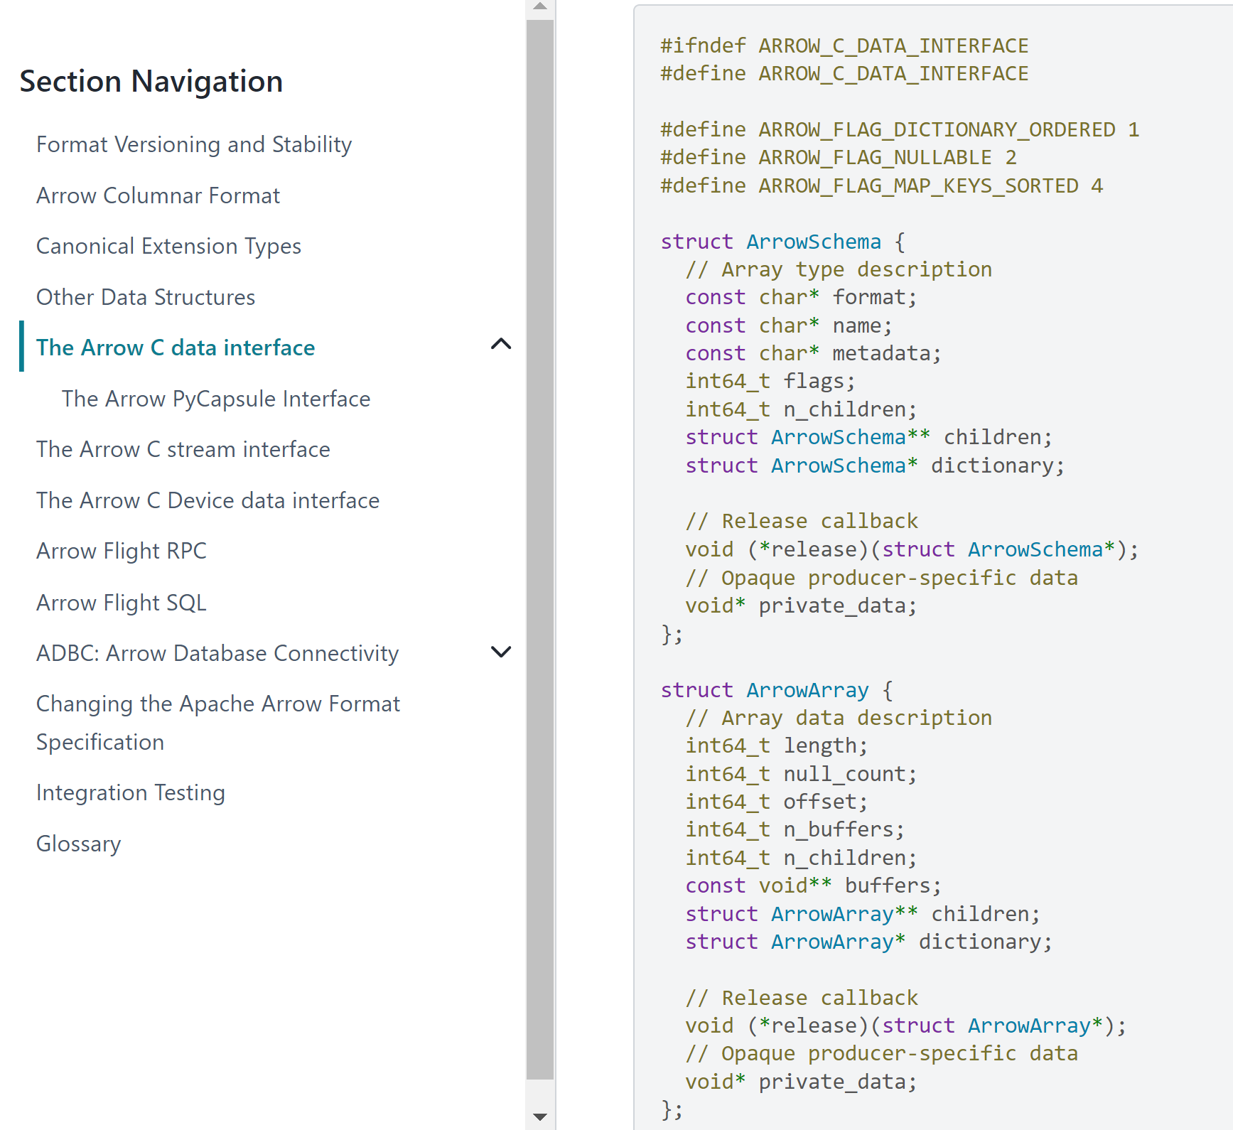
Arrow - C

Slide 12
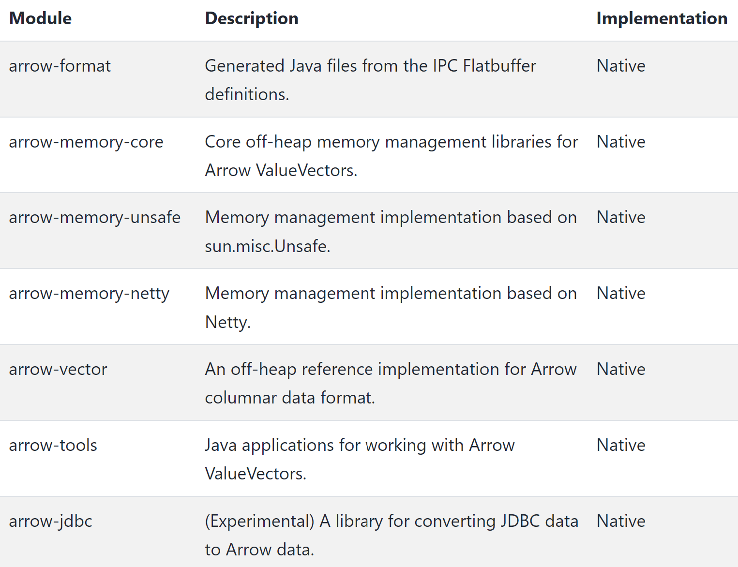
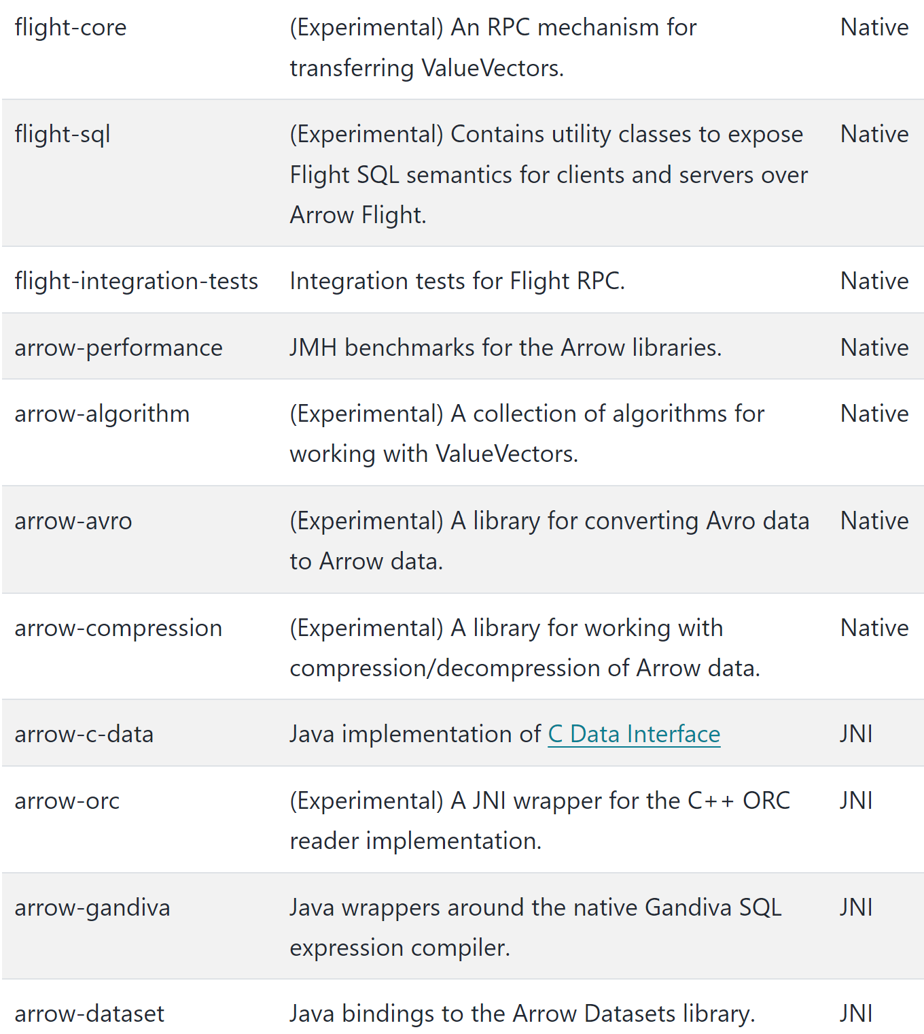
Arrow - Java Bindings

Slide 13
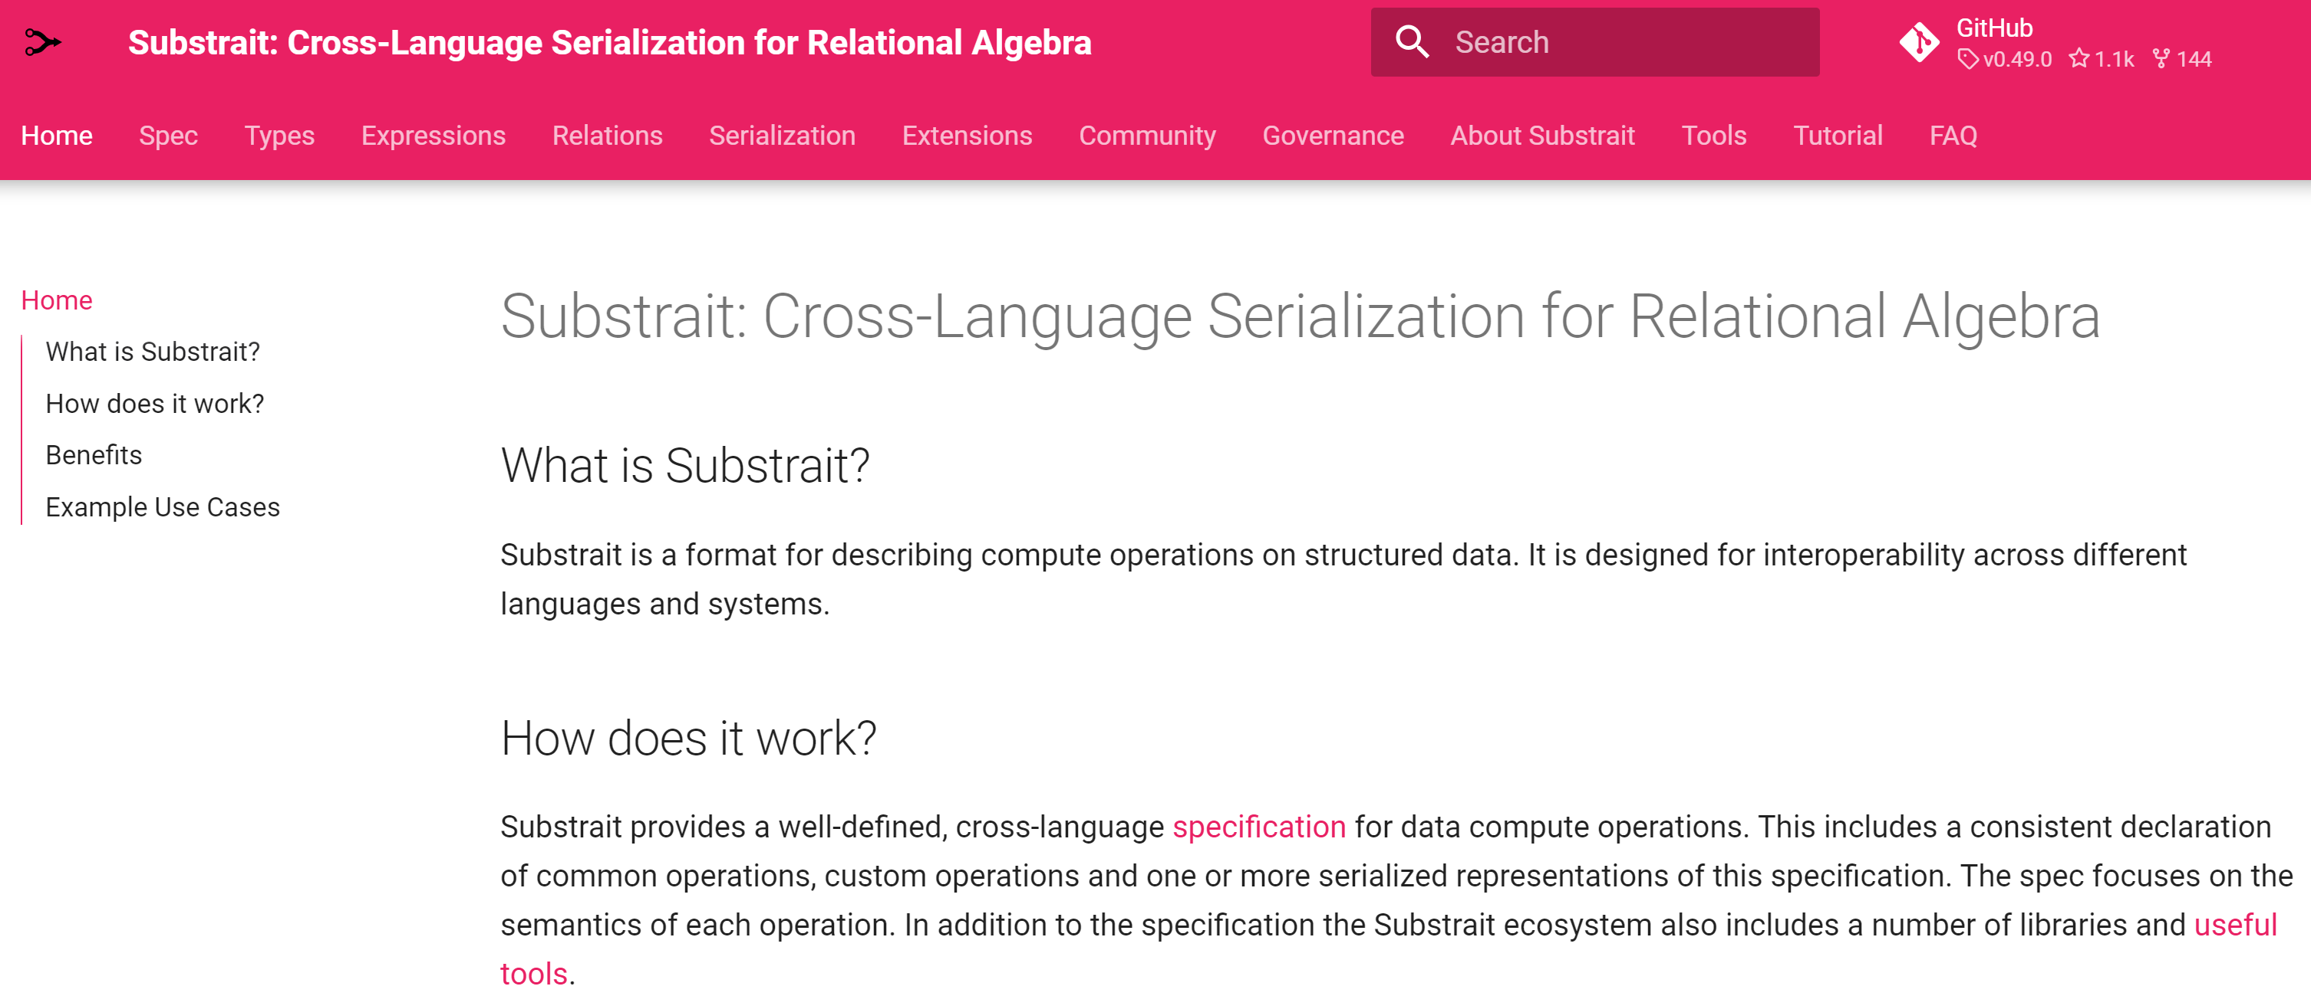
Substrait
https://substrait.io/

Slide 14
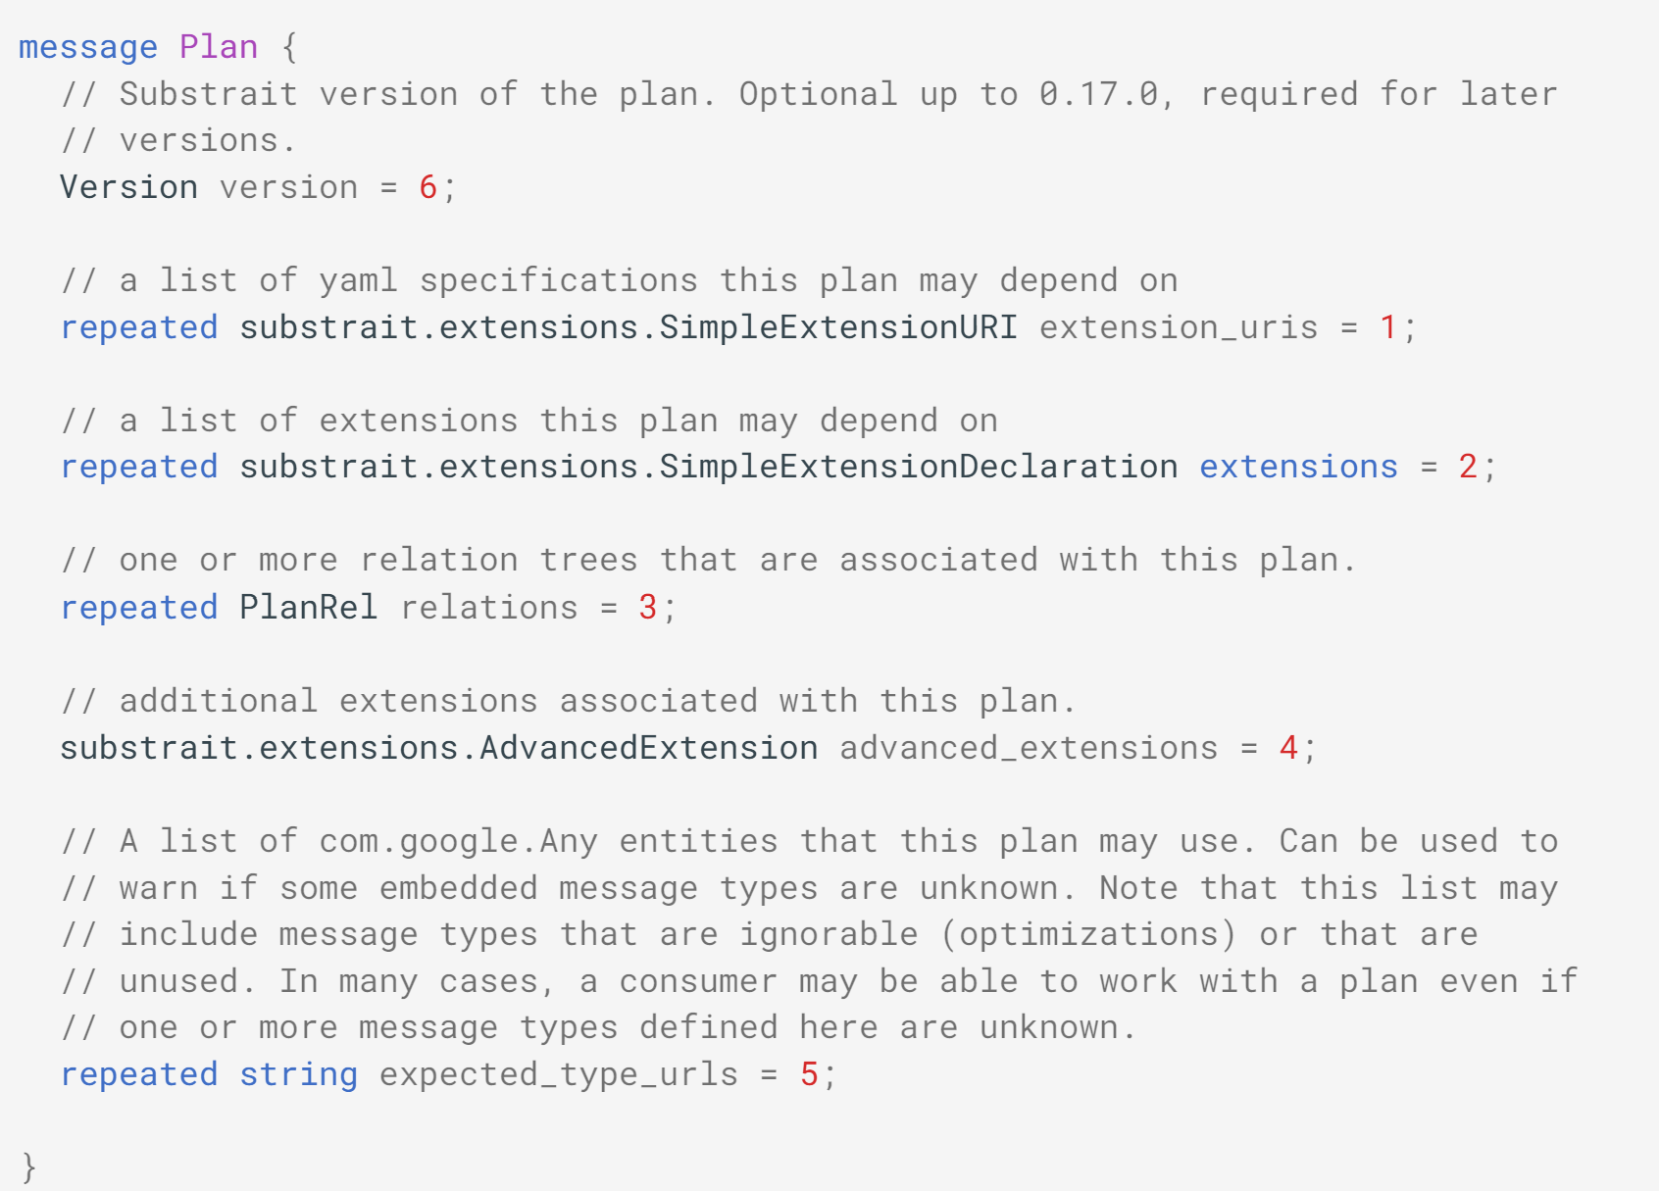
Substrait Plan in protobuf

Slide 15
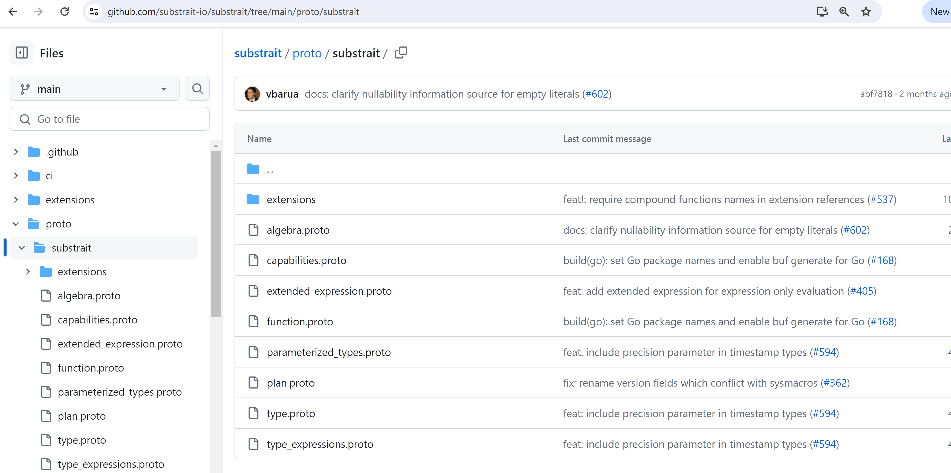
https://github.com/substrait-io/substrait/tree/main/proto/substrait

Slide 16
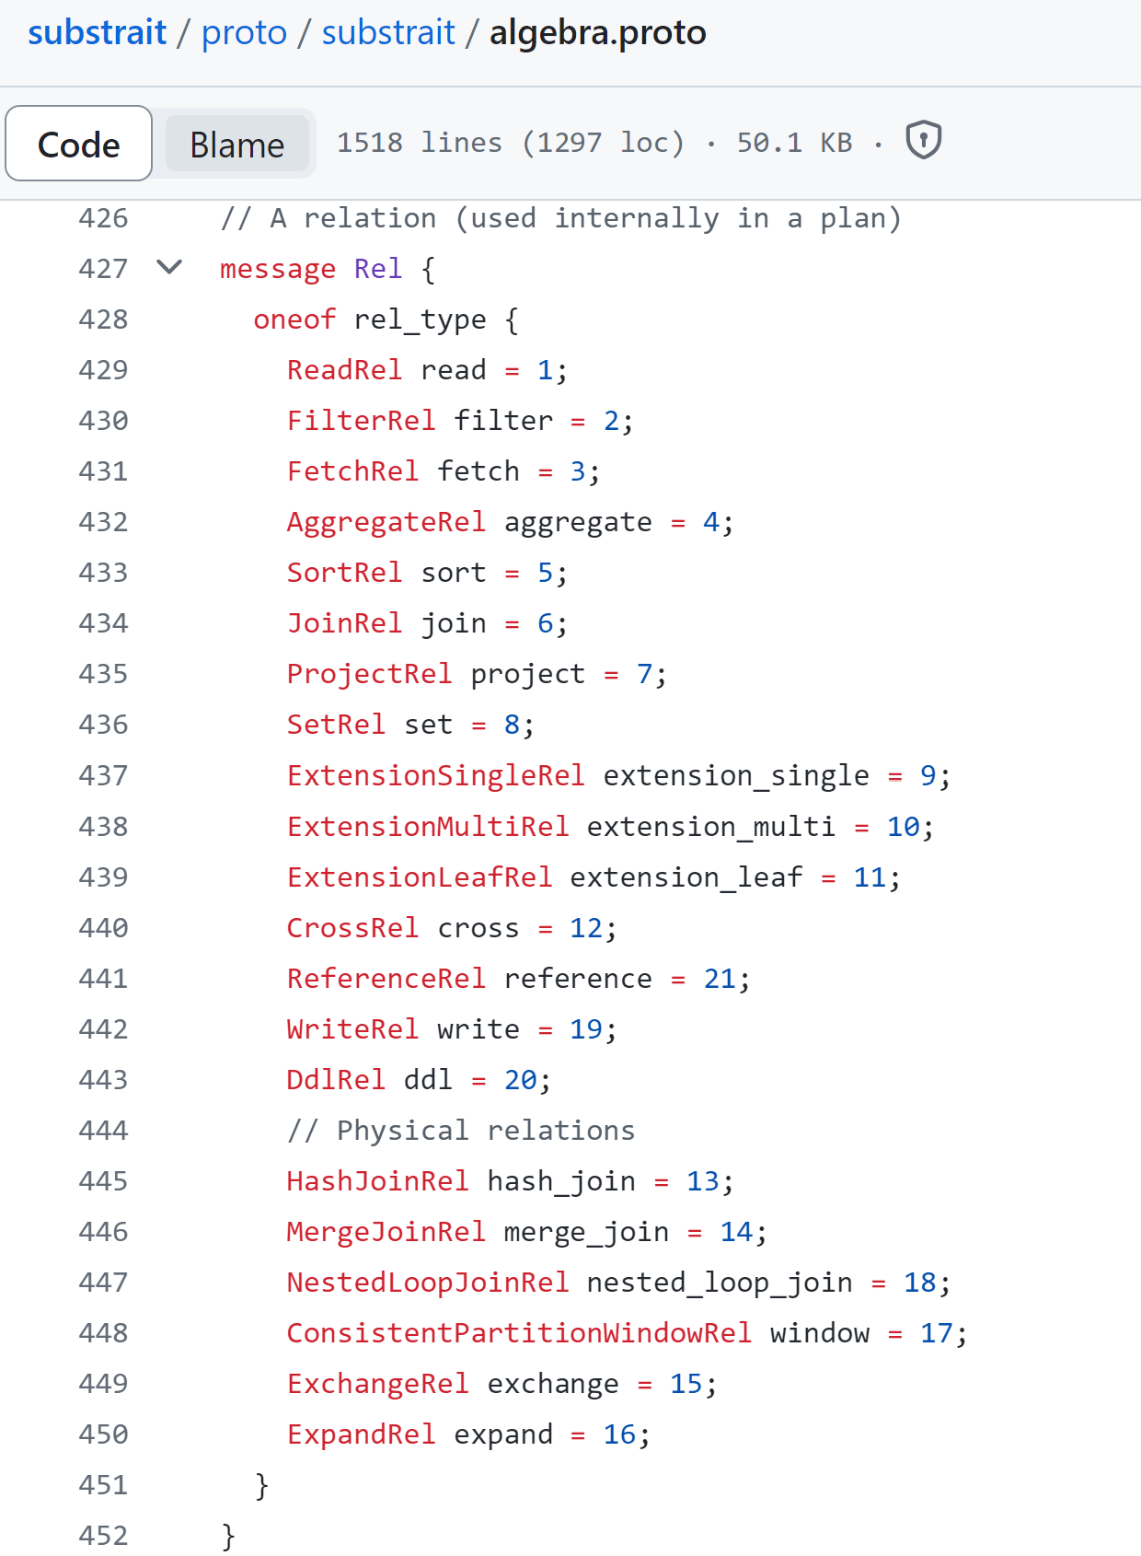
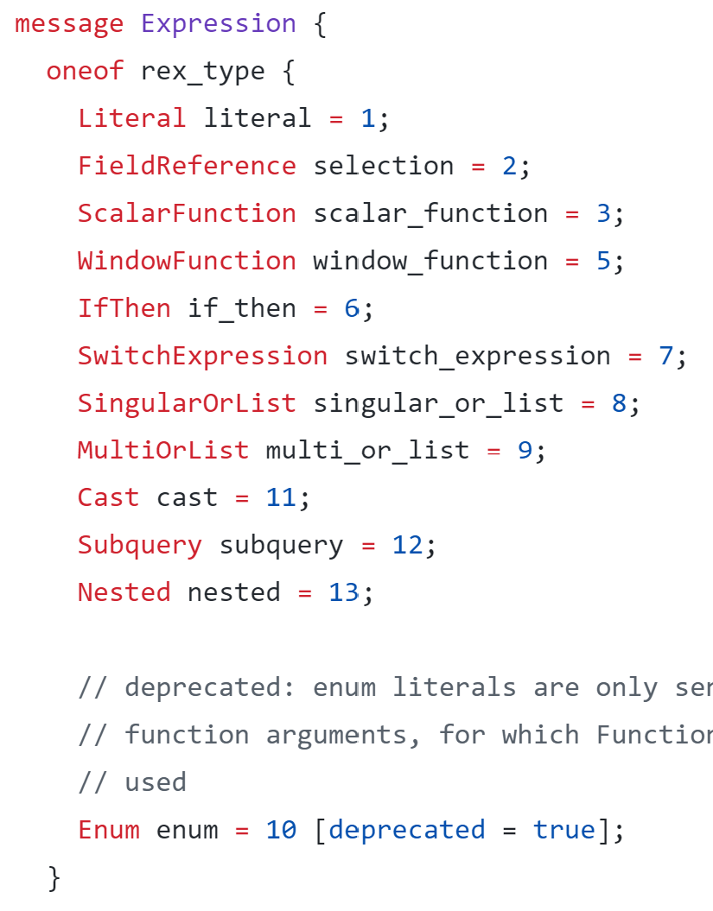
algebra.proto

Slide 17
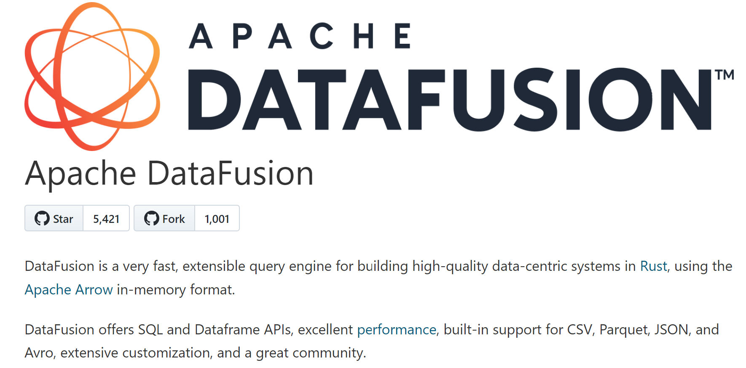
Datafusion
https://datafusion.apache.org/

Slide 18
DataFusion
DataFusion (Rust)
Arrow (Rust)
Arrow

Slide 19
Ballista ( DataFusion )
Ballista (Rust)
DataFusion (Rust)
Arrow (Rust)
Arrow

Slide 20
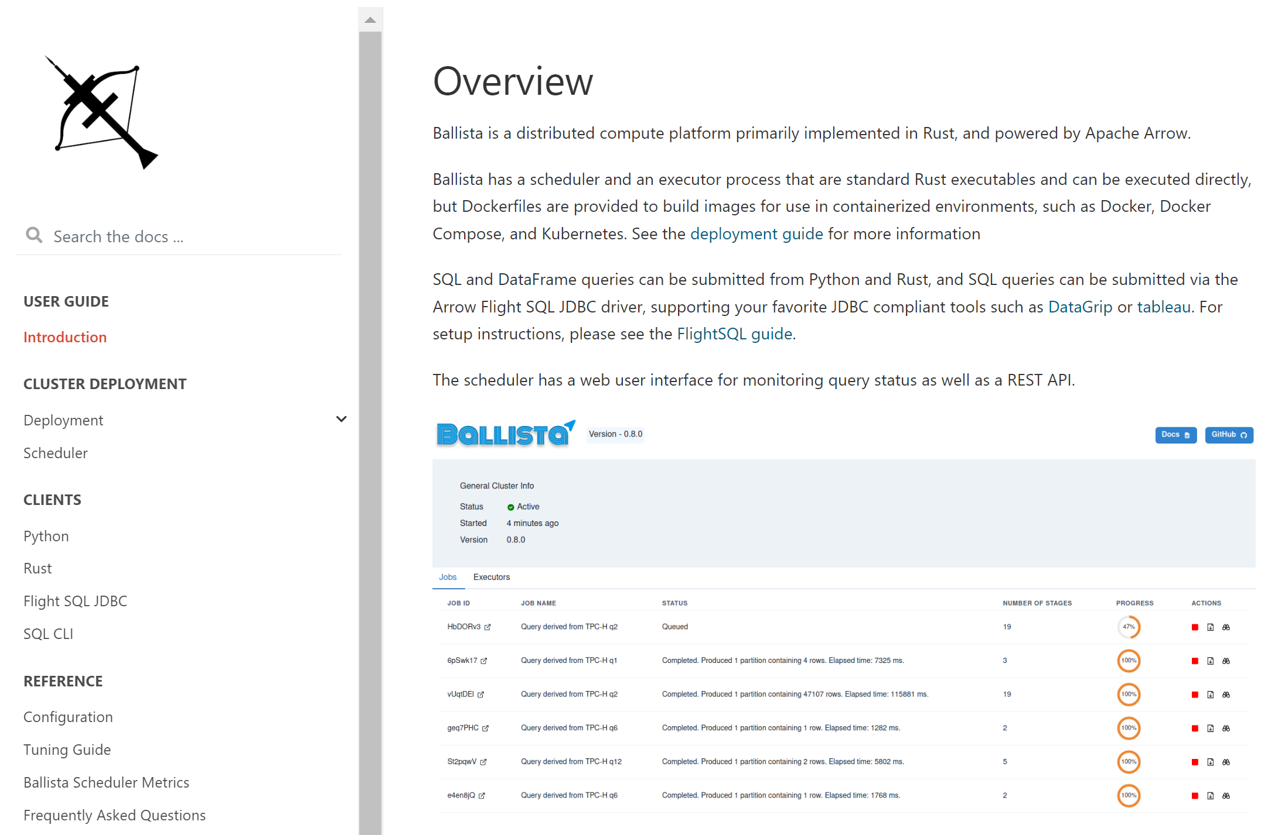
https://arrow.apache.org/ballista

Slide 21
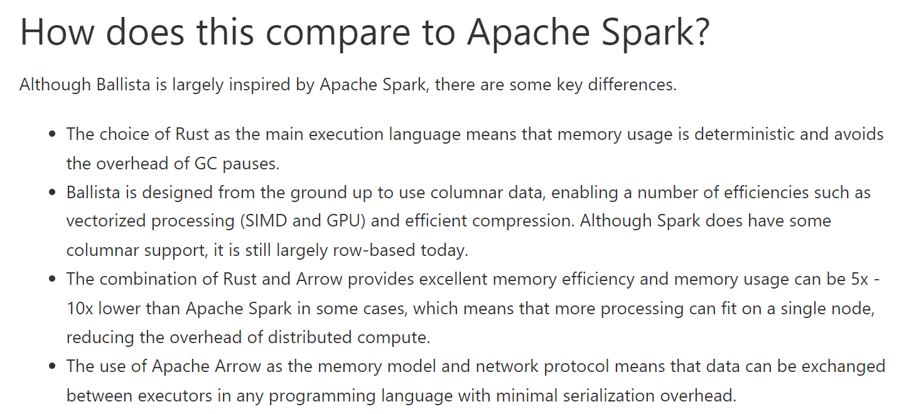
Ballista
https://arrow.apache.org/ballista/user-guide/introduction.html

Slide 22
Spark Comet Plugin (to DataFusion)
Comet
(Spark Plugin)
Spark
(Core)
Substrait
(Java)
Substrait
(Rust)
Substrait (Spec)
DataFusion (Rust)
Arrow (Rust)
Arrow

Slide 23
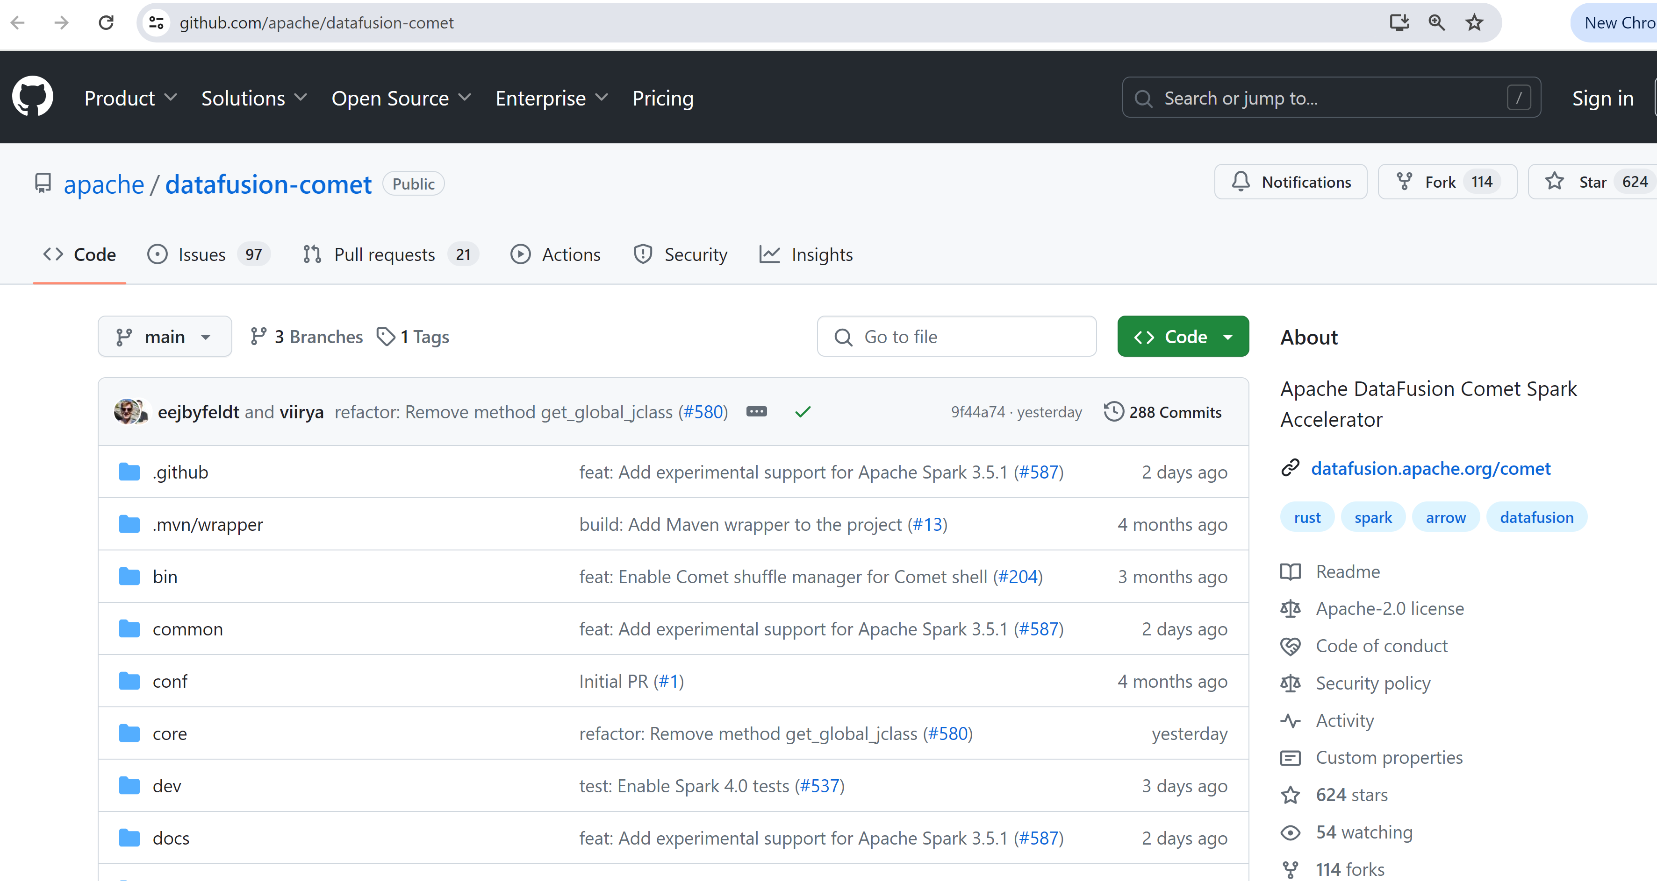
Comet
https://github.com/apache/datafusion-comet

Slide 24
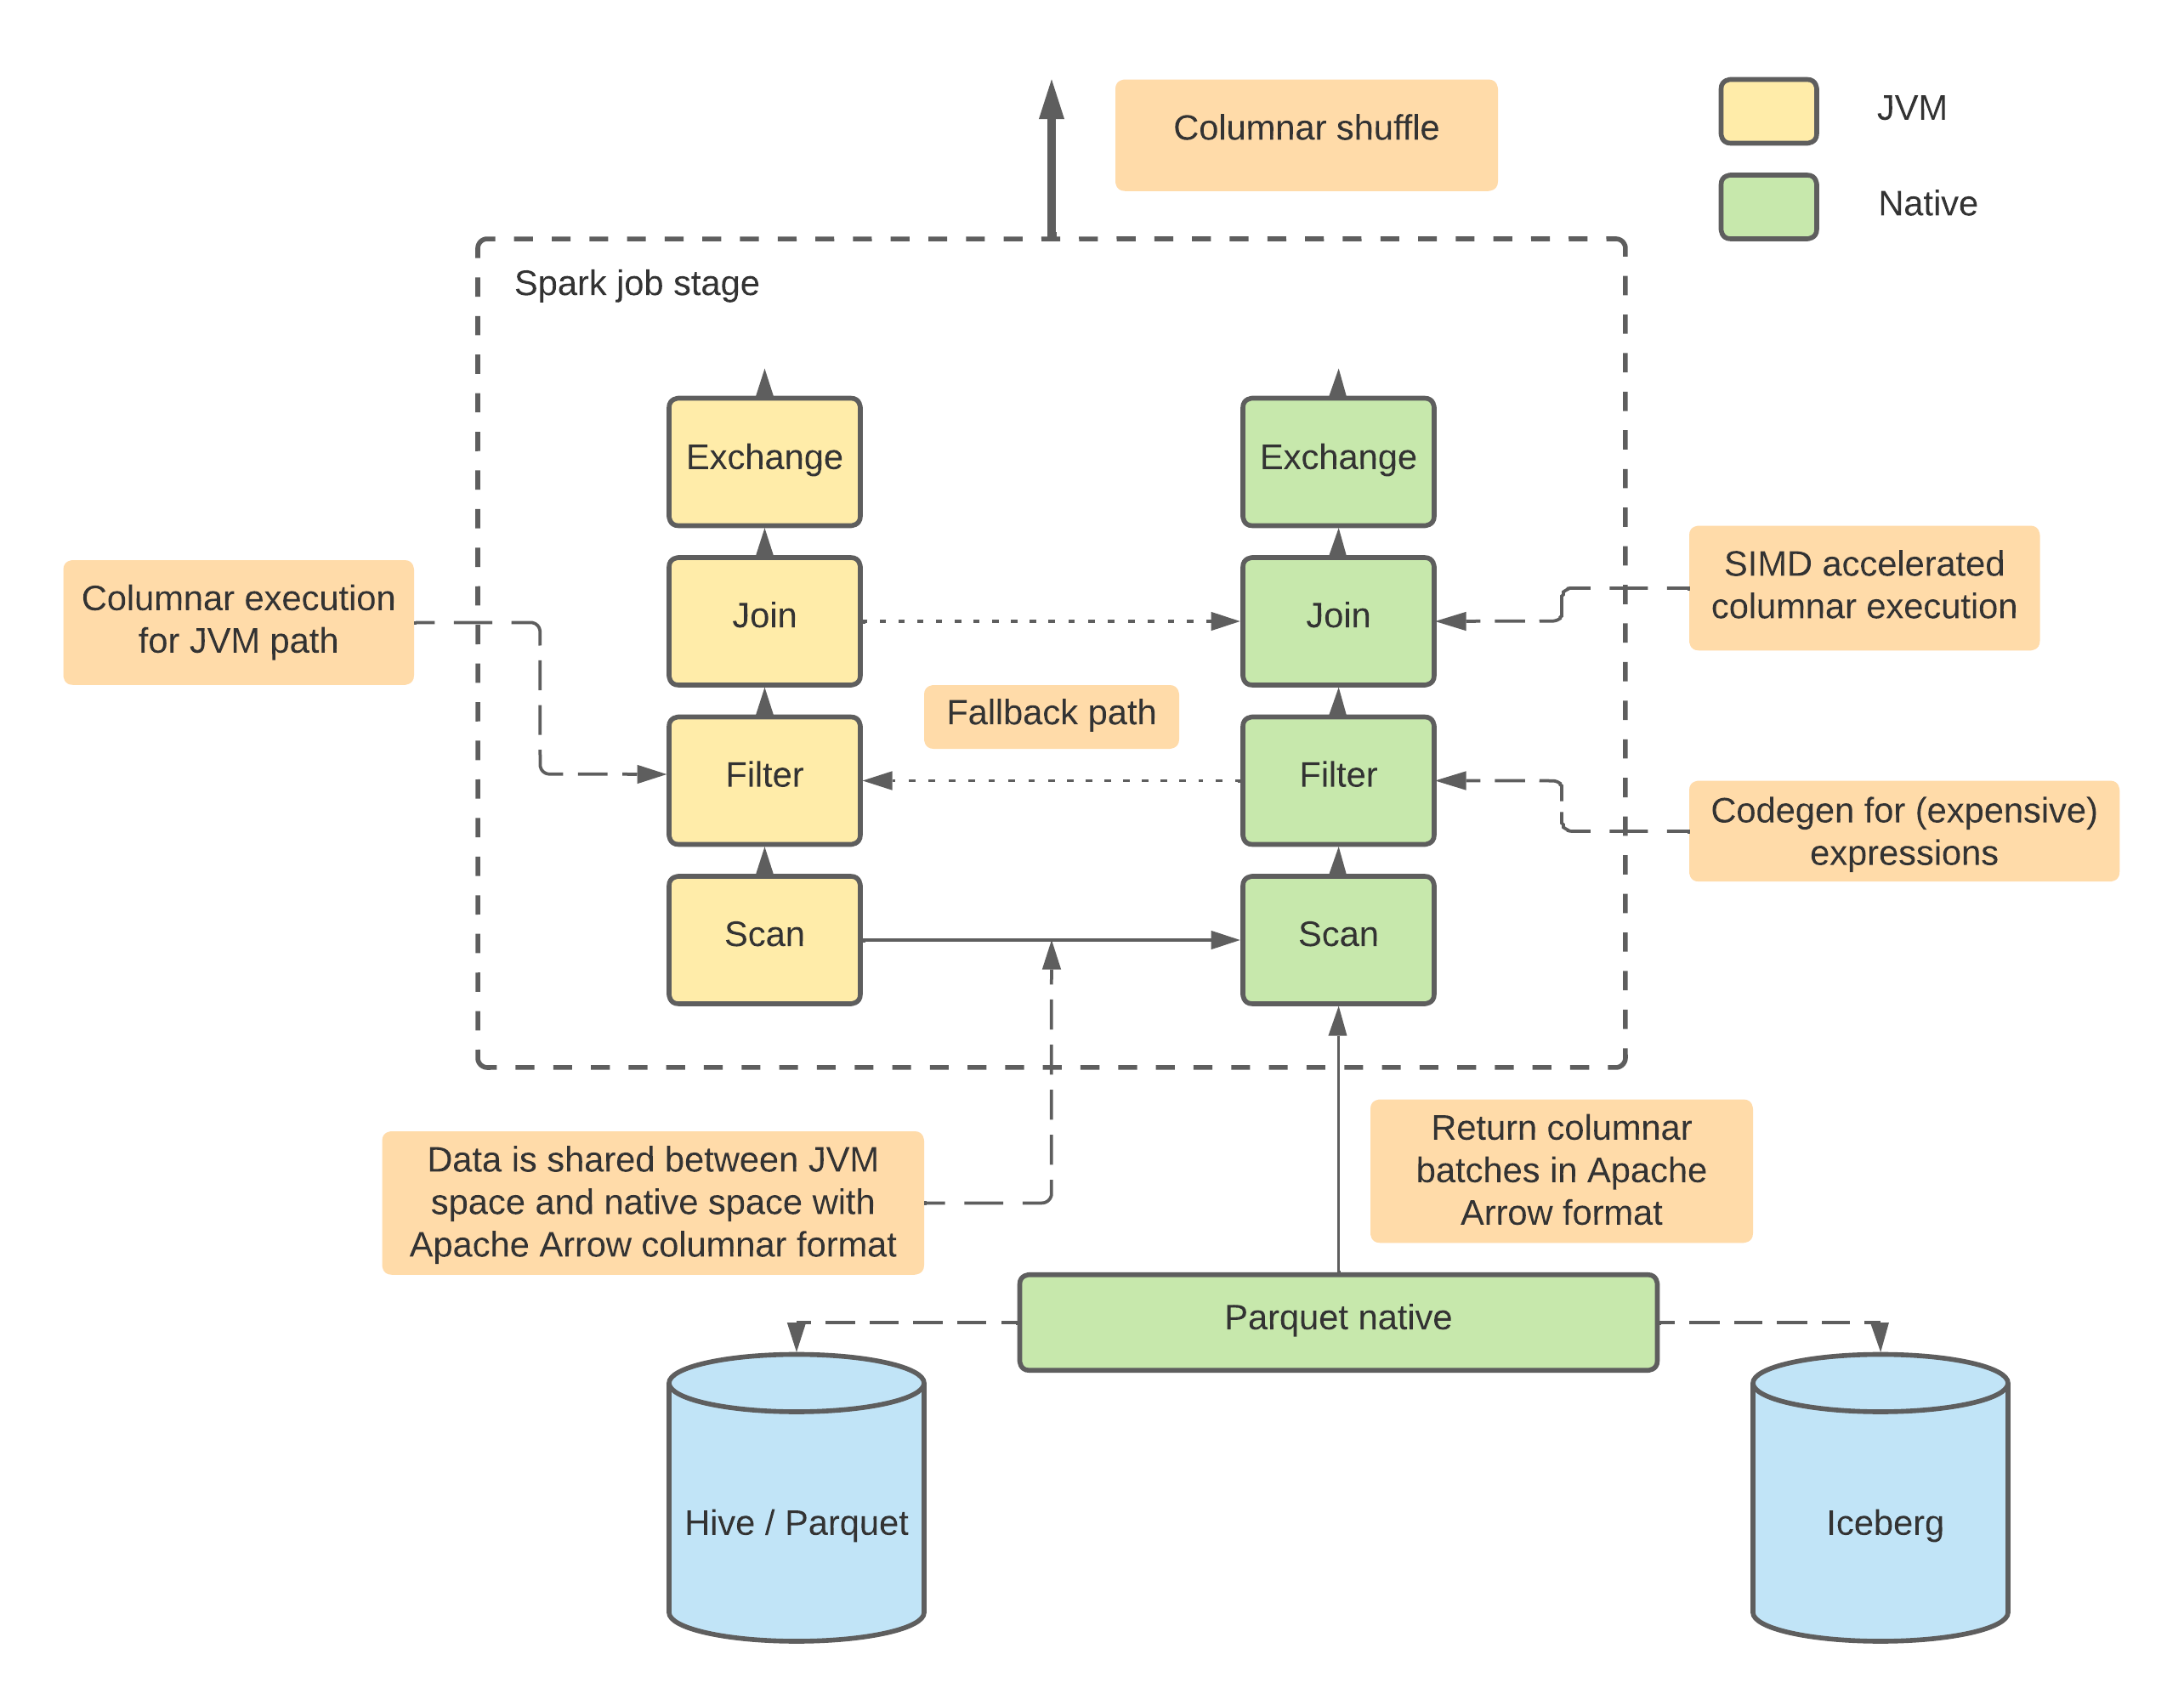
Datafusion Comet
https://datafusion.apache.org/comet/user-guide/overview.html

Slide 25
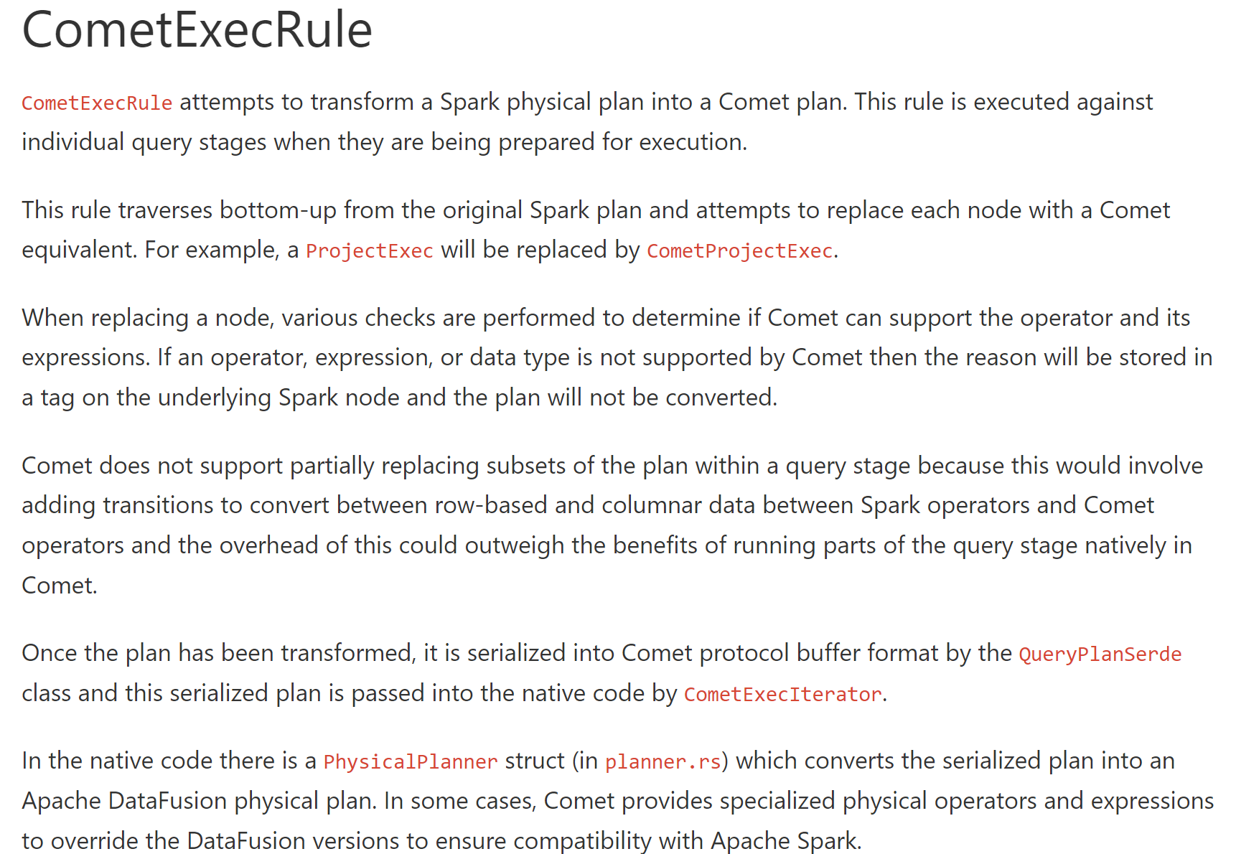
Comet internals

